Slide 1
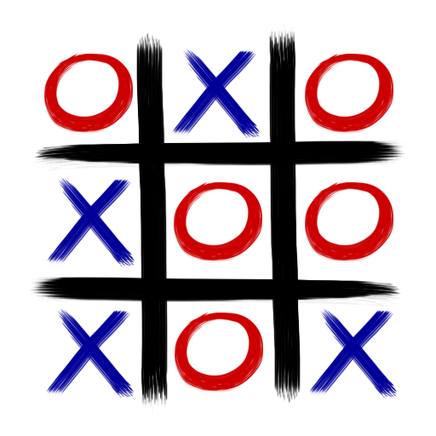
UOE TEAM 2 (TIC TAC TOE)
A new Take on a Classic Game 1300 BC to AD 2022
Notes:
Intro to the Presentation Set the scene of what is to come

Slide 2
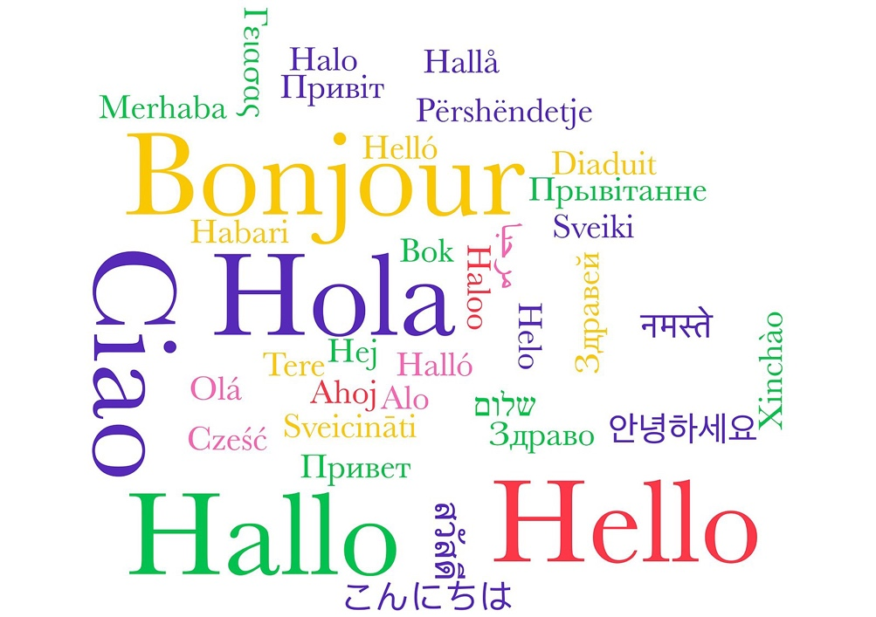

Introduction
Meeting Agenda
Team Introduction

Slide 3
Design Process Updates
Your Project Design
Introduction
Dynamic Updates
System Scale out
Language
Devices & Speed

Slide 4
DESIGN Process
Those who plan do better than those who do not plan, even though they rarely stick to their plan.” – Winston Churchill
We chose the waterfall model to complete this project. Business needs and requirements must be present at the start when using the waterfall methodology. This enables the analytic team to identify the business needs and requirements precisely, improving the output in terms of meeting the needs of the organization. When team members are spread out across the nation or the globe, this strategy can be highly productive. Additionally, a waterfall model requires fewer resources to deploy than alternative approaches
We will now pass off to one of our other members (Sathira) to give a more detailed overview of the waterfall process

Slide 5
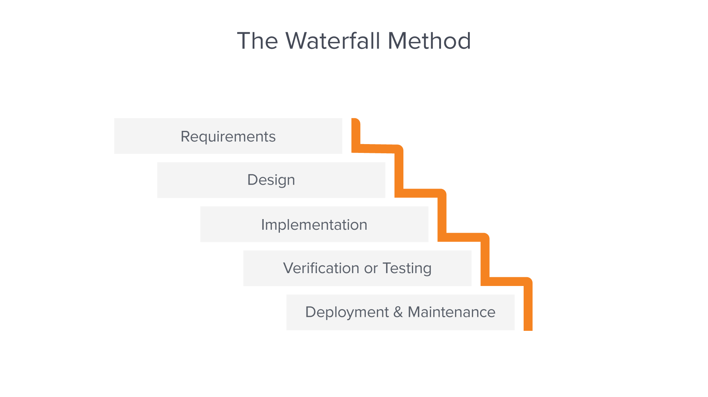

Waterfall
Requirements – We collaborated with the other team and gathered the scope and scenarios for the project.
Design – The development of the technical solution, which included the tech stack being used, logical design and the scope of the application was finalized during this stage.
Implementation – During this stage the developers worked on developing the code base for the agreed upon requirements.
Verification/Testing – After the development was completed the QA did the manual testing as well as the automated testing to ensure there are no issues in the UI as well as the code it self.
Deployment and Maintenance – After all the testing was completed we built a pipeline which will do deployments to our docker image.

Slide 6


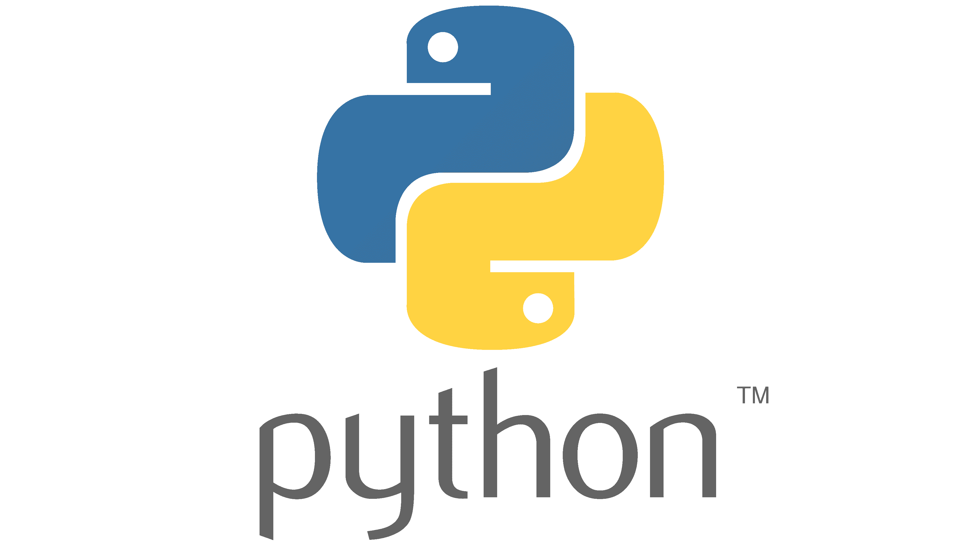


Your Game Technology Stack
Python (Development Language)
Docker (Microservices Container Engine)
Traefik (SSL Reverse Proxy)
Portainer (Container Management)
Lets Encrypt (SSL Certificate Provider)
Firebase (DBMS Key Store)

Slide 7
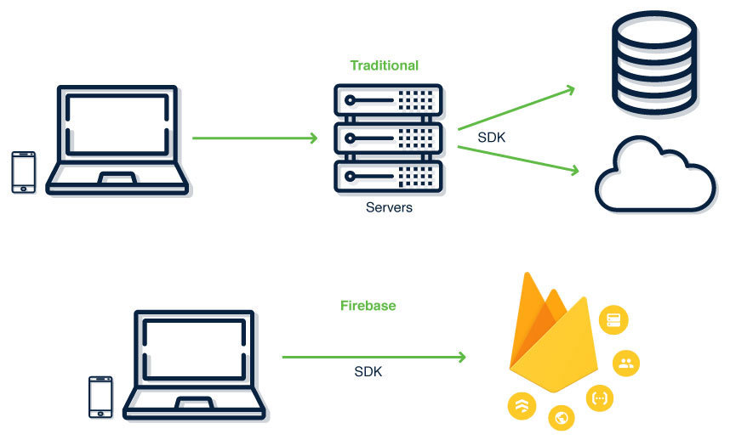
Firebase
Firebase was used to complete authentication and authorization
Firebase allows us not to store user login information on databases managed by our team.
Firebase is GDPR compliant.
Register page and login page are all connected to the firebase service via API connection.

Slide 8
Testing
We employed a mixture of testing techniques while testing the application
Manual Testing
Automated Testing
Hybrid Testing

Slide 9
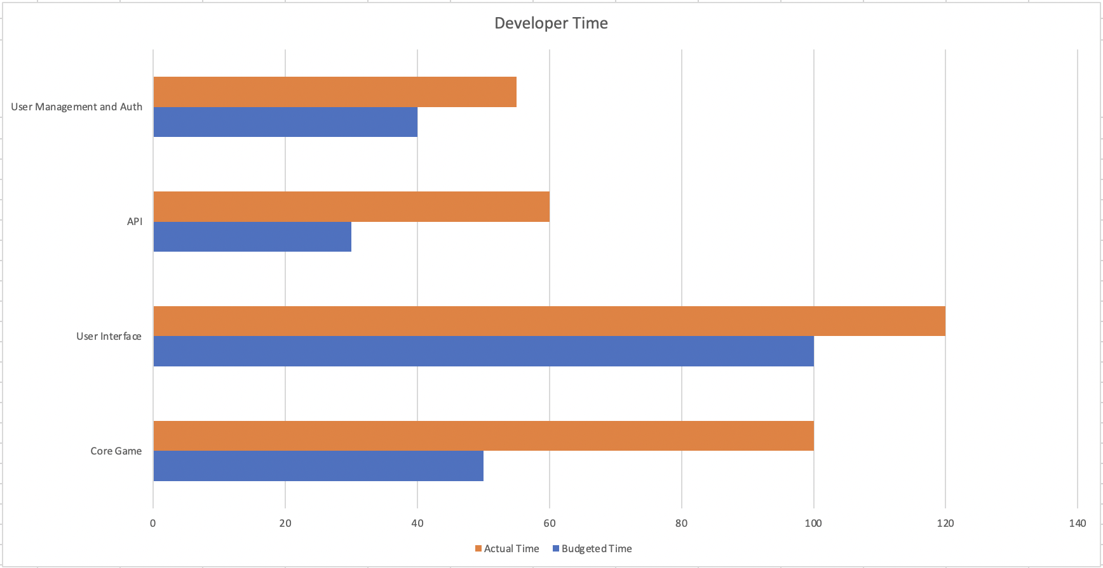
COSTS
There's no point in making predictions. It's not worth speculating because nothing is set in stone and things change - Cristiano Ronaldo

Slide 10
Level | Salary Per Annum (£)
Junior | 38000
Middle | 57000
Senior | 80000
To Get indictive hourly rate we will take the mean of the levels
38000 + 57000 + 80000 / 3 = 58333
From this we can calculate an average daily rate
58333 / 365 = Daily Rate of £159.81
If we then take this value and divide by 8.0 the standard working hours in day in a 40 Hour working week, we get an adjusted hourly rate of £19.97.
From this we can calculate the development cost of the solution is £6492.28 this is higher than predicted due to the time taken being longer then first predicted along with increased inflation pressures driving up developer pay meaning development now costs more than it did just a few weeks ago

Slide 11

Key Project Risks
Requirements Interpretation
The first of these was the requirements for the project being quite open this meant that a fair amount of interpretation was required in that regard to what you would like in your solution I think we would have preferred a more ridged requirements that being said having creative freedom was welcome and we hope you like the solution that has been provided.
Distributed Development Team
The second risk that we encountered was that due to the distributed nature of the development team it was not always as easy to communicate then if the team was centrally located.
Knowledge
The Third Risk we encountered was the members of the team are not experts therefore some of the choices and decisions made may not be the same as those made by a team with a wider knowledge base or real world experience this was most apparent in prediction of time as time predicted for a task to take place did not align with what actually happened with some more experience this could be overcome but for this initial phase this proved to be a challenge.

Slide 12
Path to production
Security / Monitoring
Step one is to strengthen the security position of the solution while hosting and infrastructure security is outside of our remit as developers, we would recommend putting in IDS monitoring solution in place and ensuring that there is full auditing of users and configuration events.
We also recommend a regular penetration test of the solution to ensure that the game and underlying supporting services and infrastructure are secure and not vulnerable to attack

Slide 13
Path to production
Resilience
Your current solution is hosted in a single datacenter, before any full scale move to production it is recommended that the solution be distributed across multiple data centers to allow for unforeseen outages and to enable the option of DR. With a move to production, we would also recommend a higher availability design on the infrastructure side to allow for failure of components without compromising the ability of users to access the game.
Support and Training
While we are happy to provide technical support for the application, we have created for your organization for longer term support we would recommend employing someone with the necessary technical skills to fully support the application once it has reached the deployment stage.

Slide 14
References
References
RAID Log | IST Project Management Office | University of Waterloo. (n.d.). Retrieved August 25, 2022, from https://uwaterloo.ca/ist-project-management-office/methodologies/project-management/planning/raid-log
PID - Project Initiation Document - purpose & contents. (n.d.). Retrieved August 25, 2022, from https://www.stakeholdermap.com/project-management/pid.html
Project Initiation Documentation :: PRINCE2® wiki. (n.d.). Retrieved August 25, 2022, from https://prince2.wiki/management-products/project-initiation-documentation/
Garcia, D. (n.d.). GamesCrafters: Tic-Tac-Toe. Gamescrafters.Berkeley.Edu. Retrieved August 25, 2022, from http://gamescrafters.berkeley.edu/games.php?game=tictactoe
Tic-Tac-Toe. (2002). Wolfram MathWorld. http://mathworld.wolfram.com/Tic-Tac-Toe.html

Slide 15

Thankyou for watching our presentation
https://www.istockphoto.com/photo/group-of-people-holding-placards-that-form-thank-you-gm508372661-45474118

